Slide 1
CNPD Course:
Data Protection Basics
23 October 2018

Slide 2
CNPD Course:
Data Protection Basics
Basic elements
Esch-sur-Alzette
Michel Sinner
23 October 2018
Head of controls
Compliance Department
Notes:
Welcome - Presentation of myself
Aim of Workshop is introduction to data Protection for beginners - Try to explain concepts in non-legal language (as far as possible)
We have a lot of presentations and no questions will be taken at the end of each presentation. But we do bundle the questions after 2 presentations.
What is personal data – Exercice – show of hands – no control if wrong
Social security number (matricule)?
Family and given name?
Your home address?
Telephone number?
Your company identification number (RCS number) No
Bank account number?
Amount of wages you earn? No
Marital status? No per se.
IP Address?
Voice recording?
A Photo? Depends of the subject – tree or animal No, person Yes.

Slide 3
Outline
Introduction
Basic elements
The rights of the data subjects
The obligations of controllers and processors
The role of the CNPD
Notes:
View of todays programme
DO: read all the points, each presentation takes 25-30 minutes, questions are for 10 minutes. After a few presentations, coffee break.
Get started with the basic elements

Slide 4
Basic elements - Overview
Legal framework
What is “personal data”?
What is “processing”?
Key data protection actors
Main principles
Notes:
Going to see 5 main points
DO: read all 5 points.

Slide 5
1. Legal framework (1/3)
Regulation (EU) 2016/679 of 27 April 2016 “the GDPR”
Directive (EU) 2016/680 of 27 April 2016 (“Criminal Justice Directive”)
Act of 11 August 1982 on the protection of privacy
Amended Act of 2 August 2002, implementing Directive 95/46/EC has been repealed
Act of 1st August 2018 on the organisation of the National Data Protection Commission and the general data protection framework
Act of 1st August 2018 on the protection of individuals with regard to the processing of personal data in criminal and national security matters
  Amended Act of 30 May 2005, implementing Directive 2002/58/EC (electronic communications)
Notes:
DO: Give explanations on the various texts.
Directive 95/46 needed to be implemented nationally – we ended up with differences in national interpretations.
Therefore, choice to use a EU regulation that will be directly applicable in all EU member states.
Law of 2002 has been repealed by the Law of 1st August 2018 on the organisation of the CNPD and the general data protection regime – updates to policies may be necessary (if not done under GDPR yet)

Slide 6
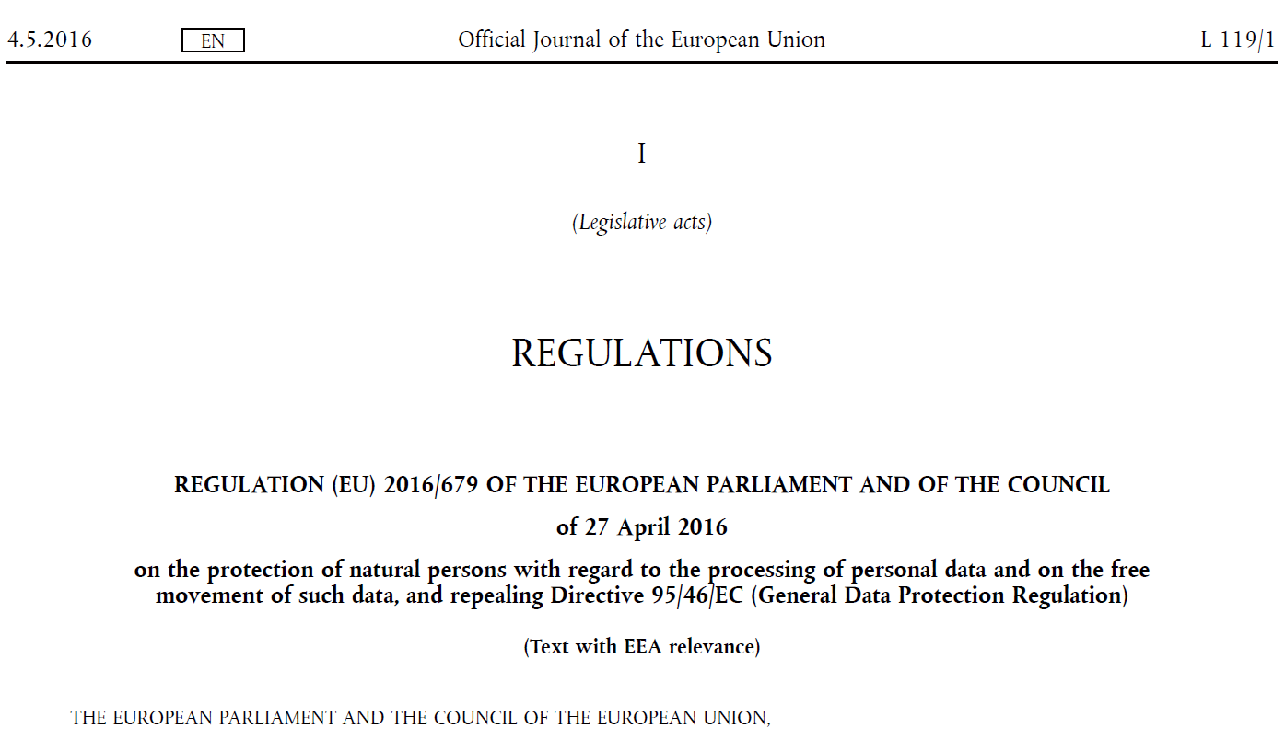
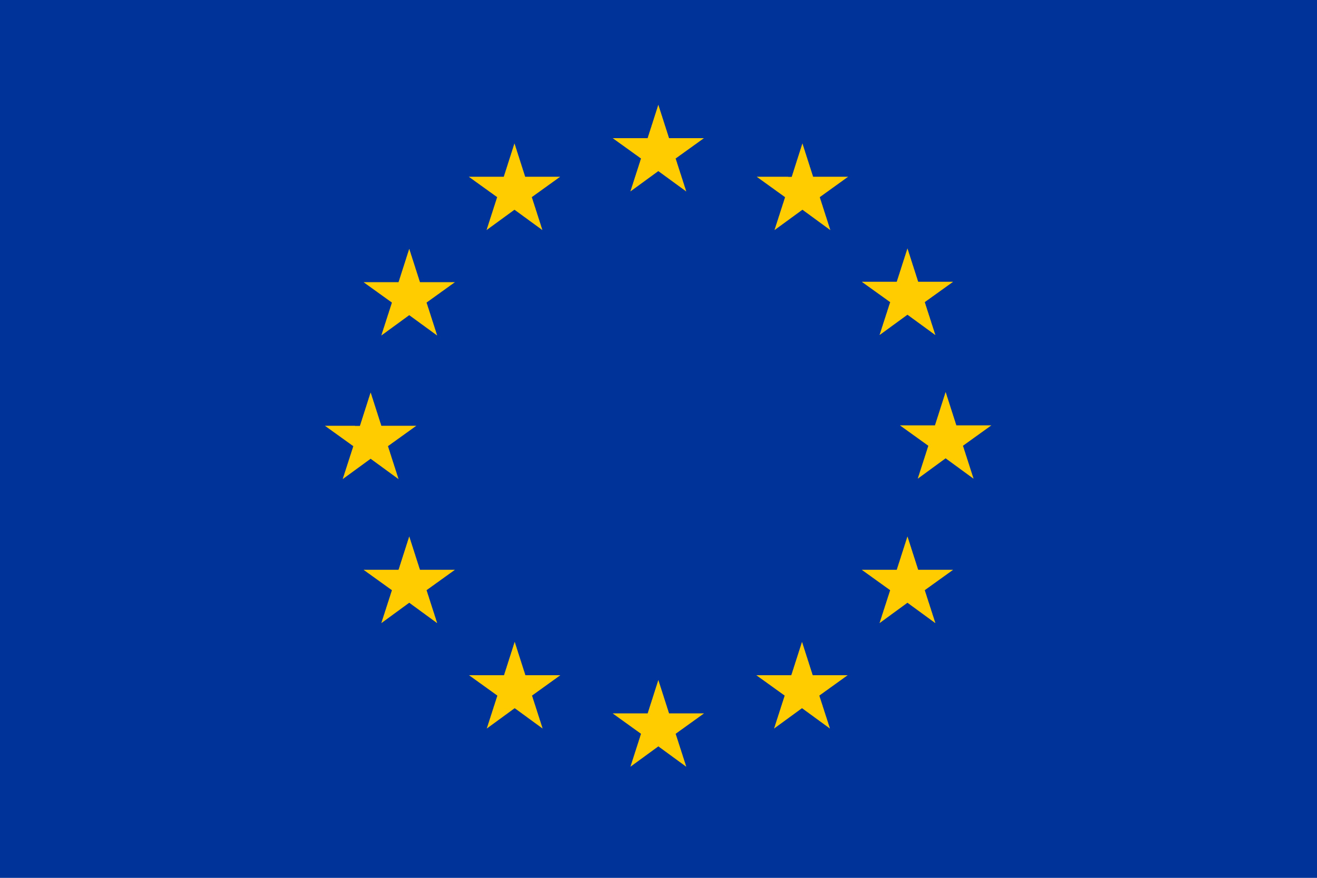
1. Legal framework (2/3)
New legal framework
  Strengthening of individuals’ rights
  An increased responsibility for controllers
  A more important role for data protection authorities
Harmonisation:
  The same rules in all 28 countries of the EU
  Directly applicable (since 25 May 2018)
  To all organisations active on EU territory
“GDPR”
Notes:
Directive dates from 1995 – since then we have seen a serious evolution on how data is processed and used
New technologies and services
Globalisation
Now Harmonisation and new legal framework– read

Slide 7
1. Legal framework (3/3)
Prior formalities
Prior control
A paradigm shift
  Less bureaucracy, yet more demanding for controllers and processors
Principle of Accountability
Subsequent control
Notes:
We have witnessed a real paradigm shift
Going from a prior control regime to the principle of accountability.
In practice: means that the authorizations and notifications obligations have ceased to exist. But undertakings that are processing data must be able to demonstrate at all times that they comply with data protection rules.
Results in less bureaucracy, but it ismore demanding, also for supervisory authorities such as the CNPD.
CNPD will control compliance (audits, on-site inspections, etc.)

Slide 8
2. What is “personal data”? (1/3)
“Any information relating to an identified or identifiable natural person …”
Article 4(1) GDPR
Notes:
DO: read definition. This definition is very important as it defines the GDPR’s scope of application.
One can encounter many data types, but as soon as it enters the framework of the definition of « personal data », the specific legal regime of GDPR will be applicable
DO: read the rest of the definition – insist on the « identifiable »
“an identifiable natural person is one who can be identified, directly or indirectly, in particular by reference to an identifier such as a name, an identification number, location data, an online identifier or to one or more factors specific to the physical, physiological, genetic, mental, economic, cultural or social identity of that natural person” (GDPR definition)
DO: make link with the brainstorming exercice

Slide 9
2. What is “personal data”? (2/3)
“Clear text data”:
Data that allows the immediate identification of a person
Pseudonymised data:
Possibility to identify a person after a more or less significant research effort
Anonymised data:
Absolute impossibility to link the data to a specific person
Notes:
DO: Read clear text (no legal concept!) and pseudonymised data.
Art 4 (5) Definition pseudonymisation : means the processing of personal data in such a manner that the personal data can no longer be attributed to a specific data subject without the use of additional information, provided that such additional information is kept separately and is subject to technical and organisational measures to ensure that the personal data are not attributed to an identified or identifiable natural person
PSEUDO: Even if the individual who is processing the data cannot himself identify the person behind the data, the law still applies, as the data controller (even via a third party) can identify the person → pseudonymised data.
Example: researchers, which only obtain reference numbers, but no names of the person to which the data relates to. But there exists a “conversion list”.
Clear text data and pseudonymised data do enter the framework of the data Protection law/GDPR.
Anonymised data are out the scope of the Regulation, because it is no personal data. Anonymous data is data that has been rendered anonymous in such a way that the individual is not or no longer identifiable – such data is no longer considered personal data, but it must be irreversible. (recital 26). But strict interpretation, absolute impossibility to re-identify the person!

Slide 10
2. What is “personal data”? (3/3)
Special categories of data = “sensitive data”:
racial or ethnic origin
trade union membership
religious or philosophical beliefs
political opinions
health data
data on sex life
genetic data
biometric data
judicial data
Notes:
Contrary to “Standard data”, which generally can be processed, sensitive data, by default, cannot be processed, unless you can invoke an exception forseen by GDPR. Examples: express consent (restrictive interpretation), legal obligation in the field of Labour law, necessary to protect the vital interests of the data subject, etc. 10 exceptions in article 9.2
DO: go through the categories.
Racial or ethnic origin ≠ nationality
Racial origin: controversial notion tainted by history. Generally speaking, makes reference to an classification of humans based on various physical characteristics such as skin color, bone structure, facial form, eye color etc.
Ethnical origin: term ethincity refers to a social group of people which consider sharing a common lineage or heritage, a common history or culture. Can be geographic origin, language or dialect, ideology, religion, etc.
Nationality = legal relationship between a person and a state
Data concerning health: means personal data related to the physical or mental health of a natural person, including the provision of health care services, which reveal information about his or her health status (def GDPR)
Genetic data ≠ biometrical data
Genetic data = personal data relating to the inherited or acquired genetic characteristics of a natural person which give unique information about the physiology or the health of that natural person and which result, in particular, from an analysis of a biological sample fron that person. (human tissue cells harvested and sequenced) (def GDPR)
Biometric data = “personal data resulting from specific technical processing relating to the physical, physiological or behavioural characteristics of a natural person, which allow or confirm the unique identification of that natural person (such as facial images or dactyloscopic data)” (GDPR definition) (fingerprint scan for Access control)
Judicial data: data relating to the judicial activities or past of an individual. Ex: criminal record.

Slide 11
3. What is “processing”? (1/2)
“Any operation or set of operations which is performed on personal data or on sets of personal data, whether or not by automated means, such as collection, recording, organisation, structuring, storage, adaptation or alteration, retrieval, consultation, use, disclosure by transmission, dissemination or otherwise making available, alignment or combination, restriction, erasure or destruction”
Art.4 (2) GDPR
Notes:
The definition is very broad, includes almost everything
Exclusion: activities by a natural person in the course of a purely personal or household activity : family album or private address book

Slide 12
3. What is “processing”? (2/2)
The life-cycle of a processing activity:
Collection
Use
Analysis / profiling
Conservation
Deletion
“Simple“ deletion
Anonymisation
Transmission
Mailing (newsletter)
Storage
Billing
Notes:
Standard lifecycle of a “data processing”!
The first processing is always a collection: it can be direct or indirect, automatic or manual, with or without consent.
Exemple: taking an image or recording a sound, a form to be filled out, etc...
The last processing is always a deletion: either a simpel deletion or an anonymisation.
Between these two steps, the possibilities are nearly limitless.
“Special” processing activities:
1.“Usual” processing BUT relating to sensitive data
Example: “usual” data processing, like a transmission of data intra group in the same country, but the concerned data is “sensitive data” – more restrictive conditions will apply.
2.“Standard” data BUT processing is deemed “risky”
Second example concerns “Standard” data (like an address file or an image), but the processing is deemed “risky”. Ex: videosurveillance in the workplace.

Slide 13
4. Key data protection actors (1/3)
Data subject
Third parties
Supervisory authorities
Controller
Processor
Data protection officer
Notes:
Data subjects =>“any natural person who is the subject of a data processing” (art 4.1)
Third parties => any natural or legal person other than the data subject or controller or processor
Def GDPR: “a natural or legal person, public authority, agency or body other than the data subject, controller, processor and persons who, under the direct authority of the controller or processor, are authorised to process personal data”;
Supervisory authorities - Data Protection authorities => national independent public authority ensuring the application of the provisions of the regulation – details in the presentation of my colleague Dani Jeitz
Other notions expained in next slides

Slide 14
4. Key data protection actors (2/3)
Controller
  determines the purposes and means of the processing
Processor
  processes personal data on behalf and upon instruction of the controller
Notes:
Controller: “the natural or legal person, public authority, agency or any other body which alone or jointly with others determines the purposes and means of the processing of personal data.” The one who decides of the “what (target) and how (means, how to get there)”.
Processor: “a natural or legal person, public authority, agency or any other body which processes personal data on behalf of the controller” – important: there is subordination, and only acts upon instructions.
Cannot use the data for his own purposes. See it as the controller is the Head and the controller is the Arms.
Relationship controller/processor: the determination of the quality of controller or processor is analysed “processing by processing”, especially as there may be multiple actors involved.
Ex: intra-group relations, the parent company will not automatically be the data controller.
Example of a customer file => purpose and means are decided upon by the subsidiary, the data is communicated to the parent company for storage purposes. Here the subsidiary is the controller and the parent is processor.
Problem is that both roles can be found within the same company, depending on its Business model.
Controller and Processor in one entity: Internet provider offers data storage solutions. Here the provider is processor for the client (i.e. company using the provider for hosting its data).
But, the internet provider is to be considered being a controller for all the data processed for its own needs (client file, marketing activities, etc).

Slide 15
4. Key data protection actors (3/3)
Data Protection Officer
  Safeguards the application of the legal requirements within the company
  Designation is mandatory in certain cases
  Professional qualities and expert knowledge
  Independent
  Must be given adequate resources & time to fulfil duties
Notes:
Data Protection officer: internal or external person designated by the data controller OR processor, which mission is to ensure supervision of the controllers/processors compliance with the Regulation and laws for the company which employs or recruited him.
Some important items changed relating to the DPO:
No more accreditation by the CNPD, but professional qualities are requested by GDPR (Expert knowledge of Data Protection law) & ability to fulfil tasks
The contact details of the DPO must be published and communicated to the supervisory authority (point of contact for data subjects and supervisory authorities)
Public authorities or bodies MUST designate a DPO – legal obligation. The whole “public sector”, except courts.
Idem if core activities require monitoring of data subjects on a large scale or if core activities consist of processing on a large scale of sensitive data
Faculty for the other entities to designate a DPO
One DPO can cover more entities (organizational structure and size to consider)
More information on our website

Slide 16
5. Main principles (1/7)
Accountability
Purpose limitation
Lawfulness, fairness and transparency
Accuracy
Data minimisation
Integrity and confidentiality
Storage limitation
Notes:
Data quality principles: these principles apply to all processing activities
Lawfulness, Fairness and Transparency => Lawfulness is the first principle for processing – applicable at all different stages and at all times – be based on at least one of the legal grounds provided for in the GDPR that we will see in just a minute. But it is also broader than just this aspect. It also requests to be in line with the broader set of rules that govern our society – (Example of illegitimate purpose – discriminatory profiling to charge higher prices to one ethnicity compared to another). Fairness and transparency require the processing not be hidden, have given information regarding risks and rights, an so on...
Purpose limitation => key concept in data Protection: the controller needs to determine for what limited purpose the data obtained/collected will be used
Ex: your plumber asks your data for billing purposes (no selling of the Client file, unless specified).
Ex2: Contact details given to an association of which you are a member – used for administrative Management (sending out newsletter, membership fee, informational Flyer, activities). Not OK to Exchange that data with other non-for-Profit association or sponsoring.
Data minimisation: prohibition to process data which, for the planned purpose, are inadequate, irrelevant or dispensable/not necessary. Data needs to be adequate, relevant and limited.
Accuracy and limited storage duration: data needs to be accurate – interdiction to process incorrect or wrong data, obligation to update data that became incorrect or deletion. Duration of storage will depend on the purpose of the processing.
Integrity and confidentiality: will not get into those, except that state-of-the-art technical and organisational measures need to be taken to protect the data.
Accountability: data processor will be held accountable for the respect of those principles. Legal obligations of the GDPR need to be respected, but also the compliance needs to be extensively documented.

Slide 17
5. Main principles (2/7)
3.1 Lawfulness = legal basis for processing (1/2)
      “General regime” = processing activity permitted, if :
      Consent
      Necessary for compliance with a legal obligation
      Necessary for a contract or pre-contractual measures
      Necessary for a mission in the public interest
      Necessary to protect the vital interest of the data subject
      Necessary for the legitimate interest of the controller
Notes:
Consent: (Definition GDPR): any freely given, specific, informed and unambiguous indication of the data subject's wishes by which he or she, by a statement or by a clear affirmative action, signifies agreement to the processing of personal data relating to him or her.
New definition is more restrictive, but strengthens the data subjects rights. Simple verbal consent is never sufficient. And even written or electronic consent needs to have some sort of affirmative action that, through the conduct or behavior of the data subject positively proves his or her acceptance to the processing. New is unambiguous: consent cannot be indifferent, but intentional acceptance. Ex: a preticked checkbox will not be accepted. Idem for implicit consent.
Other conditions are: freely given – no pressure, voluntary decision.
Informed: only by knowing decision-relevant information can the risks and advantages/dis-advantages of the processing be assessed. Goes to the right of information which will be covered in a later presentation, but which constitutes a key-concept.
Specific: must be related to one or more specific data processings and the purpose must be known. General consent for broad or unclear purposes will not enter the « specific » framework.
For the others – note that they all must be necessary. Necessity is overarching concept – data must be necessary.
Legal obligation: data subject is party to contract or pre-contractual measures.
Data collected needs to be necessary for the performance of the contract.
Ex: the name and address is necessary for delivering the good or the service & for billing purposes, but one would not need the measurements or dietary requirements of an individual for a mobile phone contract.
Public interest mission: this implies an official mandate, self-assessment of public interest will not be accepted
Vital interest : very rare case, protection of vital interests data subject (unconscious in hospital), but also epidemics or natural catastrophies discussed amongst authors.
Legitimate interest of the controller : balance of interests to be done between the (commercial) interests pursued by the controller and the fundamental rights and freedoms of the data subject
Ex. scientific research - interests of the controller vs the right of the data subject not to be part of this research

Slide 18
5. Main principles (3/7)
3.1 Lawfulness = legal basis for processing (2/2)
      Sensitive data = processing activity prohibited except for within exception of GDPR :
      Explicit consent, unless where law states that prohibition may not be lifted
      Processing is necessary for the purposes of carrying out the obligations and exercising specific rights of the controller or of the data subject in the field of employment and social security and social protection law on the basis of a legal obligation or collective agreement…
      Etc.
Notes:
Sensitive data – make reference to slide before. (racial or ethnic origin, political opinions, religious or philosophical beliefs, trade-union membership, and the processing of data concerning health or sex life)
There are 10 exceptions provided for by the GDPR – please refer to article 9

Slide 19
5. Main principles (4/7)
3.2 Purpose limitation
Purpose = objective pursued by the controller for the processing of personal data
        Purpose(s) must be defined in advance
        Data must only be collected for specified, explicit and legitimate purpose(s)
        Data cannot be further processed in a way incompatible with the initial purposes (principle criterion = reasonable expectation of the data subject)
Notes:
Purpose limitation => THE key concept in data Protection: the controller needs to determine for what limited purpose the data obtained/collected will be used
Two Building blocks
What is the purpose ? Objective – goal that the controller is hoping to achieve
Very important principle, because the purpose will determine what can and cannot be done with the data
2. BEFORE the start of the processing activities.
Final aspect is that data collected for one or several purposes can’t be further processed in a way that’s incompatible with the purposes first decided upon.
Ex: your plumber asks your data for billing purposes (no selling of the Client file, unless specified). Contact details given to an association of which you are a member – used for administrative Management (sending out newsletter, membership fee, informational Flyer, activities). Not OK to Exchange that data with other non-for-Profit association or sponsoring.

Slide 20
5. Main principles (5/7)
3.3 Data minimisation
= only process the data necessary to achieve the purpose
        Data must be adequate, relevant and not excessive in relation to the purposes for which they are collected
        Need to have, not nice to have
3.4 Accuracy
= the data must be accurate and, if necessary, kept up to date
        Every effort must be made to delete or rectify inaccurate or incomplete data
Notes:
The data have to be necessary and not only useful. So you should identify the minimum amount of personal data you need to properly fulfil your purpose. You should hold that much information, but no more.
Ask yourself: Can the purpose be achieved without processing personal data or by processing less data?
Ex: marital status information is not necessary in order to enroll for a language test
Ex2: A recruitment agency places workers in a variety of jobs. It sends applicants a general questionnaire, which includes specific questions about health conditions that are only relevant to particular manual occupations. It would be irrelevant and excessive to obtain such information from an individual who was applying for an office job.
Less intrusive: Key concept of Proportionnality: the processing and the data used needs to be proportionate to the purposes they are intended to be used for.
Ex: flexitime and worktime surveillance.
Ways to do it: (show of hands) : Badge, Videosurveillance (via cameras), GPS – via mobile phone, Electronic chip implanted under your skin.
Accuracy:
Inaccurate or wrong data may harm the data subject
Inaccurate or wrong data must be rectified or erased

Slide 21
5. Main principles (6/7)
3.5 Storage limitation
= do not store data for longer than is necessary for the purposes for which the data are processed
        If the purpose is fully achieved, the data must either be (definitively) erased or (fully) anonymised
        The adequate retention period depends on the purpose → case-by-case analysis
        Data cannot be retained forever only because it might perhaps be useful one day !
Notes:
No specific storage period, but must be in relation to the purposes
In order to define the storage period, you may take into account limitation periods (délai de prescription) which may apply (3 years for wages)

Slide 22

5. Main principles (7/7)
3.6 Accountability
= implement appropriate measures + be able to demonstrate compliance
How?
        Organisational and technical measures
        Maintaining documentation demonstrating compliance with the GDPR requirements
        Transparency towards the data subject and the CNPD
Notes:
New obligation – reference to paradigm shift
No more authorisations or notifications – but have to be compliant and capable of demonstrating it
Transparency toward the CNPD: for example notify data breaches

Slide 23
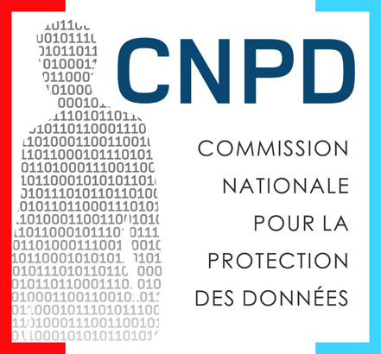
Thank you for your attention!
michel.sinner@cnpd.lu

Slide 24
CNPD Training:
Data Protection Basics
The rights of the data subject
Esch-sur-Alzette
Claudia Pfister
23 October 2018
Legal Department

Slide 25
Rights of the data subject
Right to be informed
Rights of the data subject
Right to rectification
Right to erasure
Right to restriction of processing
Right to data portability
Right of access
Right of recourse
Principle of transparency
Rights related to automated decision-making
Right to object
Notes:
DS have rights. They have now quiet a few rights that have been introduced or strengthened as a result of the GDPR. Although their importance is undeniable, it can be a real challenge for data controllers to comply with the new standards.
I’d like to begin by giving you an overview on the rights that DSs have. Don’t worry, we will check them one after another.

Slide 26

Right to be informed
The data are collected | Directly | Indirectly
The identity and contact details of the controller (& representative, if applicable) | ☑ | ☑
The contact details of the DPO (if applicable) | ☑ | ☑
The purposes of the processing, the legal basis for the processing and the legitimate interests (if processing is founded on legitimate interest) | ☑ | ☑
The categories of personal data concerned |  | ☑
The recipients or categories of recipients of the personal data | ☑ | ☑
The transfers of personal data to third countries (including safeguards) | ☑ | ☑
The storage duration (or, if impossible, the criteria used to determine that period) | ☑ | ☑
The rights of the DS | ☑ | ☑
The rights to withdraw consent (if applicable) | ☑ | ☑
The right to lodge a complaint with a supervisory authority | ☑ | ☑
The source of the personal data (incl. if from publicly accessible sources) |  | ☑
If there is a statutory or contractual requirement to provide the data, if the provision of the personal data is obligatory & possible consequences of a refusal | ☑
If automated decision-making, incl. profiling, is used (if so, meaningful information about the logic, significance & envisaged consequences for the DS) | ☑ | ☑
Further processing of the personal data | ☑ | ☑
Notes:
Let’s start with the right to be informed. DSs have to know who, what, how etc. The importance of this right is crucial as the DS can’t exercise control on his data if he does not know about the processing activity and its modalities.
This is the reason why the DS shall be provided with a whole bunch of information : SLIDE
Imagine you start a dating company. The type of company where people come to your office, tell you about themselves and their preferences so that you find the person that matches their expectations. The company does not communicate the obtained profile to anyone unless there is a match between two clients. From the introduction we learned that the information we got from the client on his lifestyle, career path and habits are personal data. We have the collection and entrance into a Computer system and are perfectly in a processing activity situation.
We learn from the slide that there is a difference being operated between data that have been collected directly from the DS (ex.: by filling out a formulary) or not (ex.: data that have been transferred from one controller to another, website, register)

Slide 27
Right to be informed
If the data are collected directly from the DS:
  When the data are collected from the data subject
  If the data are not collected directly from the DS:
    Within a reasonable time (max. 1 month) of the collection
    If the data are collected to communicate with a DS or to transmit the data to another controller → during the first communication with the data subject / to the new controller
Timeframe
Exceptions (direct)
Exceptions (indirect)
  The DS already has the information
  The DS already has the information
  Impossible or disproportionate effort
  Collection or disclosure foreseen by law
  Professional secrecy
Notes:
In the latter case, the DS must be informed within a reasonable period after the Controller obtained the personal data (max 1 month).

Slide 28

Right of access
The right to be informed whether or not their data are being processed and, if so, the right to access the data and to be informed about
The purposes and the categories of personal data concerned
The recipients (in particular in third countries)
The storage duration (or the criteria used to determine that period)
The DS rights, incl. the right to lodge a complaint with a DPA
The source of the personal data (if collected indirectly)
If automated decision-making, incl. profiling, is used (if so, meaningful information about the logic, the significance & consequences)
The right to receive a (free) copy of the personal data
Elements
Timeframe
Exceptions
  Without undue delay and in any event within 1 month of the request (possible extension of 2 months)
  The right shall not adversely affect the rights and freedoms of others
Notes:
Another right is the right of access.
According to the GDPR, the DS has the right to obtain from the controller confirmation as to whether or not personal data concerning him are being processed and, if so, he must be granted access to the data concerned. In practice the DS can send in a data-access-request. The DC must make sure to respond within a month. So the dating company from our example is strongly advised not to ignore the request because it is obliged to deliver a response without undue delay. (2 months if numerous or complicated)
Of all these data, the DS can ask to receive a copy for free.
Let’s go back to our Dating company again. In case one of our clients sends the company a written request specifying he wants to know to whom we communicate his data. Then the company cannot ignore this request but has to answer within 1 month and provide the DS with the list of recipients if there are any.
(Additional copies – possible to request reasonable fees on the basis of administrative fees)

Slide 29

Right to rectification
The right to obtain the correction or completion of incomplete or incorrect data
  Inaccurate data => rectification
  Incomplete data => completion
Elements
Timeframe
Notification
  Without undue delay and in any event within 1 month of the request (possible extension of 2 months)
  Obligation to notify the rectification to each recipient to whom the data have been disclosed (unless impossible or disproportionate effort)
  Obligation to inform the DS of these recipients, at the request of the latter
Notes:
Now I’d like to turn to the right to rectification.
In case the DS notices that the personal data processed concerning him is inaccurate or incomplete, he has the right to obtain rectification of these data by the controller.
Ex.: Bill lets the dating company create a profile on him and it appears that he has indicated a wrong age. The right to rectification allows him to send the company a rectification request and have his data rectified.
Of note is that the rectification request needs to be notified…

Slide 30

Right to erasure
Elements
Timeframe
The right to have personal data deleted without undue delay, if:
  The data are no longer necessary
  Withdrawal of consent
  The DS exercises right to object
  Unlawful processing
  Legal obligation requiring deletion
  Without undue delay and in any event within 1 month of the request (possible extension of 2 months)
Exceptions
Notification
  The right of freedom of expression and information
  Compliance with a legal obligation
  Reasons of public interest in the area of public health
  Archiving purposes (in limited cases)
  The establishment, exercise or defence of legal claims
  If the personal data have been made public, inform controllers that an erasure request has been made
  Obligation to notify the erasure to each recipient to whom the data have been disclosed (unless impossible or disproportionate effort)
  Obligation to inform the DS of these recipients, at the DS’ request
Notes:
Another right is the right to erasure (or right to be forgotten) which basically means having the right to be deleted. It is not an absolute right and allows the DS to have its data deleted in some situations:
ex.: newspaper who reports about a public affair. legal obligation to keep records in commercial law. In case an offence has been committed, DC might need the data to engage a legal proceeding.

Slide 31
Right to restriction of processing
Content
Consequences:
The right to obtain restriction of processing
When?
Rectification request
Objection request - unlawful processing
Objection request - illegitimate interests
Data is no longer necessary
Storage period of data
« Prohibited processing »
Notes:
The right to restrict processing means usually to stop for now, while the situation is being analysed.
⇨ If the DS tells the DC that the data have to be corrected…(restricted)…while DC checks it
⇨ If the DS has contested…(restricted)…while DC considers it
However, in some situations, it gives an individual an alternative to requiring data to be erased.
If it turns out that the DC’s processing activity has been unlawful (the DS was right), the DC must not continue processing. Further processing is prohibited.

Slide 32
Right to data portability
The right to receive the personal data concerning him or her from the controller
The right to transmit those data to another controller where technically feasible

Slide 33
Right to data portability
Is it personal data concerning the data subject?
Yes
No
Is the processing carried out by automated means?
Yes
No
Is the legal basis for data collection consent or contract?
Yes
No
Are the data provided by the data subject?
Yes
No
Would the portability adversely affect the rights and freedoms of others?
No
Yes
Data portability
Assessment of the rights of all parties
Data portability
Notes:
The right to data portability allows the DS to receive the personal data, which it has provided to a controller, in a structured, commonly used and machine-readable format and to transmit them to another DC(if technically feasible). It is both, a right to receive data and to transmit data from one controller to another.
In order to know whether the DS can exercise his right to data portability, a few questions need to be answered:
SLIDE
Ex.: For example, a data subject might be interested in retrieving his current playlist (or a history of listened tracks) from a music streaming service, to find out how many times he listened to specific tracks, or to check which music he wants to purchase or listen to on another platform. Similarly, he may also want to retrieve his contact list from his webmail application, for example, to build a wedding list, or get information about purchases using different loyalty cards, or to assess his or her carbon footprint

Slide 34

Right to object
The right to object to processing of his or her personal data at any time of the processing
The particular situation of the data subject
+
Legitimate interests of the controller, OR
The performance of a task carried out in the public interest or in the exercise of official authority
Compelling legitimate grounds of the controller, which override the rights of the DS
The right to object
Conditions for exercise
Exceptions
Consequences and timeframe
The controller cannot use the data for marketing purposes
Where the data are used for marketing purposes, including profiling for direct marketing
Restriction pending the verification of the legitimate grounds and, if not valid, erasure, if requested by the data subject
The establishment, exercise or defence of legal claims
Without undue delay and in any event within 1 month of the request (possible extension of 2 months)
Notes:
Excluded – paragraphe on research activities art. 21(6)
The next one is the right to object. Let’s have a look at the conditions which must be fulfilled so that the DS can exercise this right. As a data controller you might face/be confronted with the right to object when the DS is in a particular situation
If the DC processes personal data for marketing purposes, then stop using.
If the DC processes personal data to perform a task carried out in the public interest or has a legitimate interest to do so, and the DS has a particular reason to object, then the DC has to stop. (except compelling legitimate grounds). AND erase.

Slide 35
Principle – Automated individual decision-making
The right not to be subject to a decision…
…based solely on automated processing, including profiling…
…which produces legal effects…
…or similarly significantly affects the data subject.
Notes:
We can illustrate this with an example. Let’s take Luxembourg’s new speed cameras. A car drives by, a sensor detects the speed of the car, takes a photograph and a few days or weeks later, the driver receives a love letter (ticket) in his letterbox. Imposing speeding fines purely on the basis of evidence from speed cameras is an automated decisionmaking process that does not necessarily involve profiling.

Slide 36
Legal bases – Automated individual decision-making
The processing can be carried out if it is :
  necessary for entering into or performance of a contract
  authorised by Union or Luxemburgish law
  based on the data subject’s explicit consent
Notes:
Unfortunatly, we can conclude that the use of speed cameras does not lead to a situation unlawful processing.
However, even where one of the exceptions applies, the right to obtain human intervention on the part of the controller, to express his pt of view and to contest the decision.
Recital 71 says that such processing should be “subject to suitable safeguards, which should include specific information to the data subject and the right to obtain human intervention, to express his or her point of view, to obtain an explanation of the decision reached after such assessment and to challenge the decision.”

Slide 37

Transparency and modalities

Slide 38
Transparency and modalities
Put in place procedures and measures to facilitate the exercise of data subjects’ rights
  Review information notices
    Concise, transparent, easily understandable and accessible
    Use clear and plain language
  Review current procedures provided to data subjects to exercise right
    Respect the strict deadlines
    Provide easy access to information about processing and facilitate the exercise of rights
      E.g. designate contact person / department incl. contact details
    Technical and organisational measures
      E.g. internal organisation, employee training, contracts with processing, IT systems, up-to-date list of recipients
Notes:
It should be transparent to DS that personal data concerning them are processed and to what extent the personal data are or will be processed. The principle of transparency requires that any information and communication relating to the processing of those personal data be easily accessible and easy to understand, and that clear and plain language be used. That principle concerns, in particular, information to the data subjects on the identity of the controller and the purposes of the processing and further information to ensure fair and transparent processing in respect of the natural persons concerned and their right to obtain confirmation and communication of personal data concerning them which are being processed…” In short, transparency contributes to the realization of individual rights because it empowers individuals.

Slide 39
Transparency and modalities
The exercise of the rights is free, unless the requests are manifestly unfounded or excessive (esp. due to their repetitive nature)
  The request can be rejected or a fee can be charged
    Burden of proof on the controller
    Manifestly unfounded or excessive
      Does not cover the overall cost of the controllers’ processes
      Concerns the requests made by one data subject
“Customer-focused” approach:
  prompt,
  transparent and
  easily understandable communication
Notes:
⇨ Avoid information fatigue-understood by an average member of the intended audience.

Slide 40

Transparency and modalities
Designate the competent department(s) and / or contact person(s)
Confirm the identity of DS
Analyse the nature of the right(s) exercised
Acknowledge receipt of the request
Provide information on actions taken without undue delay
If no action is taken, inform DS without undue delay (max. within 1 month of receipt)
Inform DS about right to lodge a complaint with the CNPD
Information cannot be provided within 1 month:
Inform DS of the extension within 1 month of receipt of request (with reasons for the delay) possible extension by 2 months
Information provided within max. 1 month
*Uwe Kils,
Notes:
Designate competent department or the contact person in charge of data subject requests
Provide information on the actions taken without undue delay
If extended, inform the data subject within 1 month of receiving the request (indicate reasons for delay)
This means for those of you, who are DC, to…
This leads me to the next point of the presentation: Remedies.

Slide 41
Remedies
Right to lodge a complaint with the CNPD
WHERE?
Right to an effective judicial remedy against a supervisory authority
Each natural or legal person has the right to an effective judicial remedy against a « legally binding decision of a supervisory authority concerning them » or a failure to reply within three months.
Right to an effective judicial remedy against a controller or processor
Each data subject has the right to an effective judicial remedy in case of an infringement of his rights against the controller or the processor (before the courts of the Member State where the data subject has his habitual residence or the Member State where the controller has an establishment).
The supervisory authority shall inform the data subject within three months on the progress or outcome of the complaint lodged.
Authority of his habitual residence,
Authority of his place of work,
Authority of the place of the alleged infringement.
The courts of the Member State where the supervisory authority is established are competent.

Slide 42
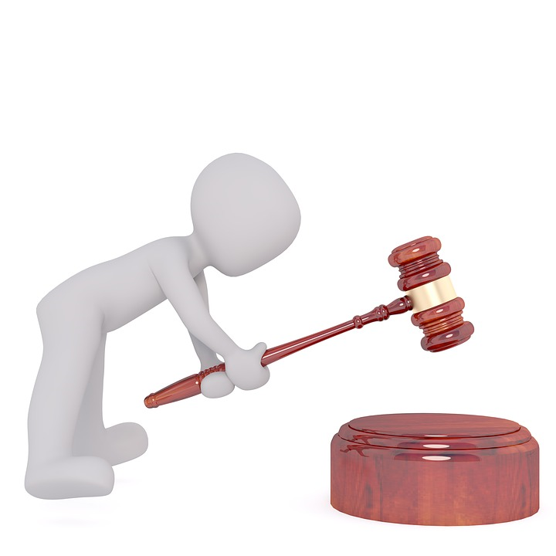
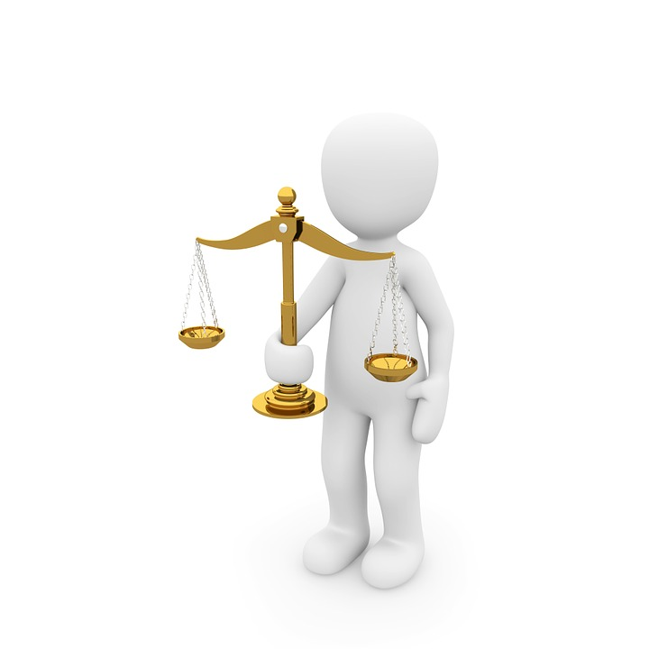
Remedies
Right to compensation
Principle: compensation for material or non-material damage suffered by any person resulting from an infringement of the Regulation can be received from the controller or processor.
Processor: Non-compliance with the obligations of the GDPR OR where it acted outside or contrary to lawful instructions of the controller.
In case of responsibility of the controller and the processor : responsibility for the entire damage
Notes:
Any person who has suffered material or non-material damage as a result of an infringement of this Regulation shall have the right to receive compensation from the controller or processor for the damage suffered.
A processor shall be liable for the damage caused by processing only where it has not complied with obligations of this Regulation specifically directed to processors or where it has acted outside or contrary to lawful instructions of the controller.
Where more than one controller or processor, or both a controller and a processor, are involved in the same processing and where they are, under paragraphs 2 and 3, responsible for any damage caused by processing, each controller or processor shall be held liable for the entire damage in order to ensure effective compensation of the data subject.
Today we’ve learned that there is a rigtht to …. . And that there is a right to recourse whenever one of these rights have not been respected.

Slide 43
Thank you very much for your attention !

Slide 44
CNPD Training:
Data Protection Basics
The obligations of controllers and processors
Esch-sur-Alzette
Mathilde Stenersen
23 October 2018
Legal Department

Slide 45
Outline
Introduction
Basic elements
The rights of the data subjects
The obligations of controllers and processors
The role of the CNPD

Slide 46
Controller obligations
Data quality principles
Record of processing activities
Security and personal data breach notifications
Data Protection Officer
Transfers to third countries
Processors
Data protection impact assessment (DPIA)
The rights of data subjects
Internal governance
Notes:
Obligations du responsable du traitement (défini par mes collègues).
Principes de qualité des données : cf. introduction.

Slide 47
1. Data quality principles
Accountability
Purpose limitation
Lawfulness, fairness and transparency
Accuracy
Data minimisation
Integrity and confidentiality
Storage limitation

Slide 48


2. Record of processing activities
GDPR: Record indicating (at least) the following information for each processing activity:
the name and contact details of the controller (…)
the purposes of the processing;
a description of the categories of data subjects and of the categories of personal data;
the categories of recipients to whom the personal data have been or will be disclosed (…)
where applicable, transfers of personal data to a third country or an international organisation (…)
where possible, the envisaged time limits for erasure of the different categories of data;
where possible, a general description of the technical and organisational security measures(…)
A document/file which describes all your processing activities
Exemples:
« Compliance Support Tool » of the CNPD which also contains a register
Other tools: CPVP (Belgian authority), CNIL (French authority)
Format: The Regulation does not specify the format of the record. While the above example may aid in the set up of the record, we advise setting up a record, which suits the needs of your organisation, both in terms of format and vocabulary.
Notes:
Based on the principles that we saw earlier today – accountability measure

Slide 49

2. Record of processing activities
Basic Checklist
Objective: Provide a practical tool to carry out a basic assessment your level of readiness for a specific processing activity
The suggested checklist is based of the data quality principles set out in the GDPR (Article 5). While not exhaustive, it may be helpful to begin the assessment your processing activities. The in-depth analysis must be made on the basis of the GDPR.

Slide 50
2. Record of processing activities
Basic Checklist
Fact sheet
Questionnaire
Data processed
Data subjects
Purposes of the processing
Erasure
List the types of data processed (e.g. names, addresses, illness notices, accountancy documents,…)
List the categories of persons whose data are processed (e.g. clients, employees, sales leads,…)
Describe the objective of the processing (e.g. payment of salary, invoicing, marketing,…)
Describe when the data will be deleted or the required processing duration
Analyse whether you decide what is done with the data or if you execute orders
Roles and responsibilities
Analyse whether you receive or transfer data to other organisations, including those located outside the EU
Data flows
 | Questions | Comment
1 | Is my processing activity lawful? | Principle: Lawfulness
2 | Have the data subject been informed about the processing activity? | Principle: Transparency
3 | Do I use data for other purposes / do I use data that are collected for another purpose? | Principle: Purpose limitation
4 | Are all the data necessary – and not only useful? | Principle: Data minimisation
5 | Are the data accurate and up-to-date? | Principle: Accuracy
6 | Must I delete the data at the end of the processing activity or are there other obligations to keep the data? | Principle: Storage limitation
7 | Are the data sufficiently secure? | Principle: Integrity and confidentiality
This document is based on the information that must be contained in the register, as required by Article 30 GDPR.
The questionnaire is based on the data quality principles, as set out in Article 5 GDPR

Slide 51
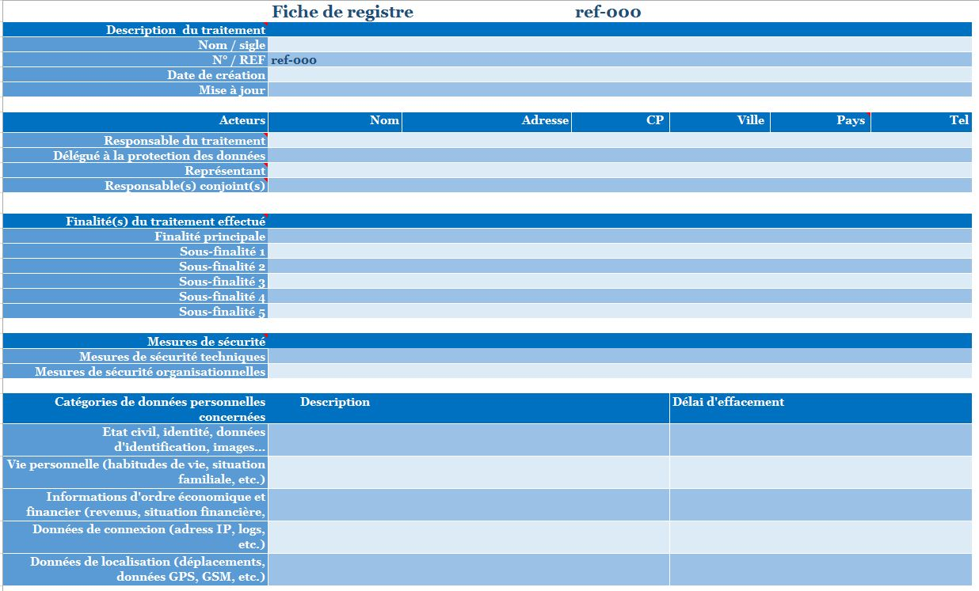
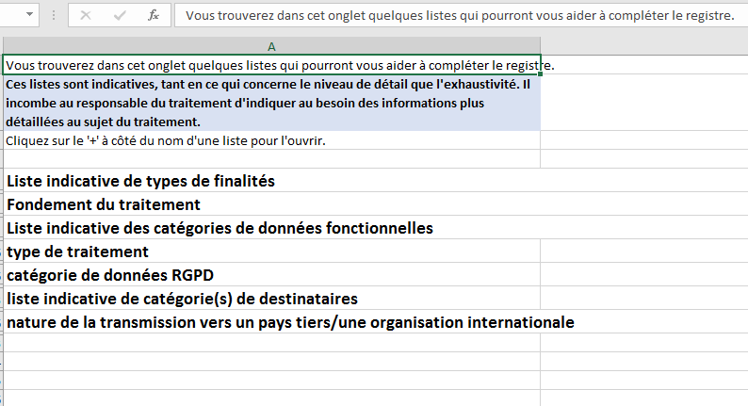
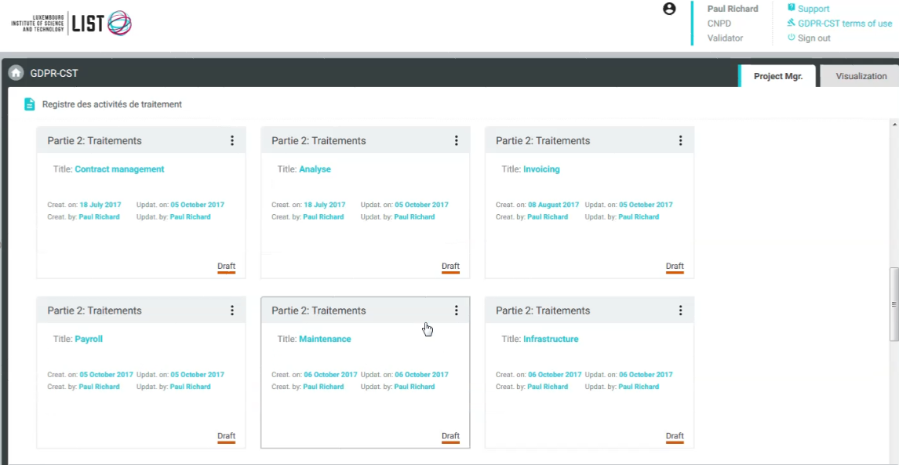
2. Record – examples
Example
@ CNIL
Example
@ CPVP
Example
@ CNPD & LIST
Notes:
Create your own register – inspiration allowed – be careful when copy

Slide 52
3. Security and data breach notifications
Technical and organisational measures taking into account
  the “state of the art”
  the risk for data subjects
Measures to reduce risk must be adapted to the context and particularities of each sector
  Analysis of risks : nature of data, legal prescriptions, complexity of the system, etc.
  The measures must be reviewed and updated on a continuous basis
  New threats every day
  New vulnerabilities
  Changes in the organisation may occur → new risks
Notes:
Security measures are likely to evolve over time – so essentially where they may be state of the art today, they may no longer be so ten years from now
Security should not only concern the IT department, but everybody – global security policy, staff training

Slide 53

3. Security and data breach notifications
Record of breaches
Notification to the CNPD
72 hours
Without undue delay
Communication to the data subject
High risk
+
Risk
+
“No” risk
Obligation of the processor to notify the controller without undue delay after becoming aware of a personal data breach

Slide 54

4. Data protection impact assessment
If data processing activities are likely to result in a high risk to the rights and freedoms of data subjects
The controller must carry out an
assessment of the impact
of the envisaged processing operations on the protection of personal data, to evaluate the risks
(Data Protection Impact Assessment - DPIA)
e.g. bike rental service with geolocation

Slide 55

4. Data protection impact assessment
The following criteria should be considered to decide if a DPIA is necessary:
Evaluation or scoring, including profiling
Automated decision-making with legal or similar significant effect
Systematic monitoring of data subject
Sensitive data
Large scale processing
Datasets that have been matched or combined
Data concerning vulnerable data subjects
Innovative use of personal data or application of technological or organisational solutions
When the processing in itself “prevents data subjects from exercising a right or using a service or a contract”

Slide 56
5. Data Protection Officer
A data protection officer will be mandatory after 25 May 2018 for a:
Public authority or body
Undertaking fulfilling certain criteria
(e.g. large scale processing of sensitive
data)
Role: Information, advice, internal compliance function and contact point for the supervisory authority

Slide 57

5. Data Protection Officer
“Pilote à bord”
Major advantage for: compliance with the GDPR obligations, communication with supervisory authorities, managing litigation and liability risk

Slide 58

6. Processing
The controller must :
  Choose a sufficiently qualified processor and always keep control of the processing activities
  Maintain oversight and control over sub-processing
  Conclude a written contract with each processing, which sets out, amongst others, that:
    The processors only processes the personal data on documented instructions of the controller
    The obligations of the controller (e.g. security measures, confidentiality) also apply for the processor
    The processor must assist the controller in being compliant with the requirements of the GDPR (e.g. rights of data subject, personal data breach notifications)

Slide 59

6. Processing
Obligations of the processor
  Only process the personal data on documented instructions of the controller
    Observe the contract concluded with the controller
    If a processor processes the data for other purposes, the processor becomes the controller for that processing activity
  Sub-processing
  Security measures
  DPO
  Record of processing activities
  Transfers of personal data to third countries
  Data breach notification
  Cooperation with the CNPD

Slide 60
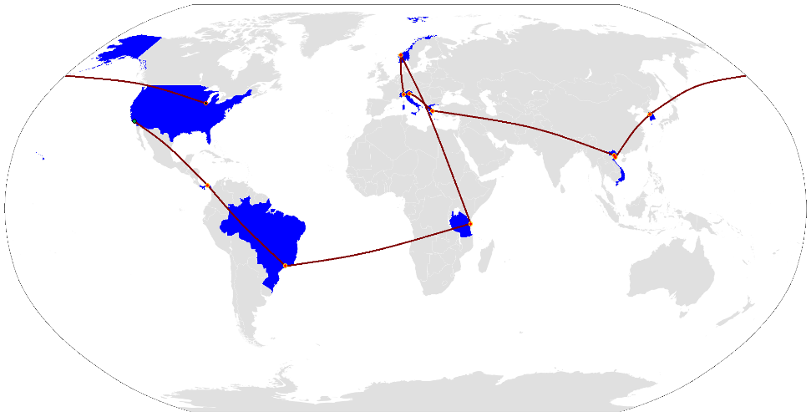
7. Transfers to third countries
Free flow of data within the EU/EEA
Transfer of personal data to third countries (= outside the EU) only possible, if:
  Adequacy decision
  Adequate safeguards (e.g. BCRs or Standard Contractual Clauses, etc.)
  Derogations for specific transfers (e.g. consent, contract, etc.)

Slide 61
8. The rights of data subjects
Right to be informed
Rights of the data subject
Right to rectification
Right to erasure
Right to restriction of processing
Right to data portability
Right of access
Right of recourse
Principle of transparency
Rights related to automated decision-making
Right to object

Slide 62
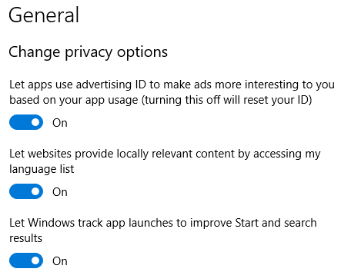
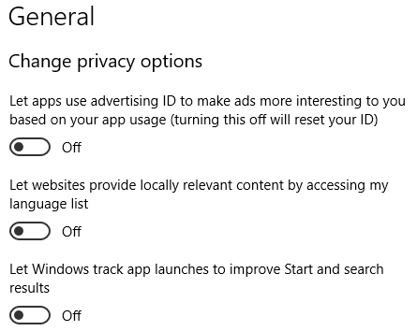
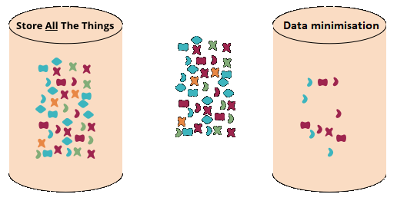
9. Internal governance
Develop a data protection friendly culture
Taking into account the principle of data protection by design and by default
(Privacy by design) (Privacy by default)
Anticipate the risks and possible issues
Be able to react promptly in case of a data breach
Develop secure data management throughout the entire life cycle of the data processing
Notes:
de prendre en compte la protection des données personnelles dès la conception et par défaut (Article 25) d’une application ou d’un traitement.
→ On reviendra à ce concept tout à l’heure
de sensibiliser et d'organiser la remontée d’information (exemple: plan de formation et de communication auprès de vos collaborateurs) ;
de traiter les réclamations et les demandes des personnes concernées quant à l’exercice de leurs droits (droits d’accès, de rectification, d’opposition, droit à la portabilité, retrait du consentement) en définissant les acteurs et les modalités (exemple: l'exercice des droits doit pouvoir se faire par voie électronique, si les données ont été collectées par ce moyen) (Articles 15-23) ;
d'anticiper les violations de données en prévoyant, dans certains cas, la notification à l’autorité de protection des données dans les 72 heures et aux personnes concernées dans les meilleurs délais (Articles 33+34) (exemple: prévoir les procédures liées à une violation de données avant que cela se réalise).
Créer une culture de la protection des données au sein de votre organisation via la gouvernance et les actions:
Tout le monde doit être concerné par cette obligation
Tout le monde doit se poser les bonnes questions – à chaque étape de vos activités
Mieux vaut prévenir que guérir
Avoir une base solide au niveau de la sécurité IT

Slide 63


9. Internal governance
Raise awareness among employees
Organise internal reporting
Implement procedures to process complaints and requests from data subjects in relation to their rights
Be transparent and inform the public about their rights
Right to information
Right of access
Right to rectification
Right to erasure
Right to data portability…

Slide 64
9. Internal governance
Document compliance
  Record of processing activities,
  DPIA,
  Framework for the transfers of personal data outside the EU,
  Record of data breaches,
  Contracts with processors,
  …
Obligation to cooperate with the CNPD

Slide 66
CNPD Course:
Data Protection Basics
Presentation of Luxembourg’s
supervisory authority
Esch-sur-Alzette
Dani Jeitz
23 October 2018
Legal Department

Slide 67
Introduction
The role of the CNPD
Independent authority organised by the Act of 1 August 2018
Public institution with financial and administrative autonomy having legal personality
Monitors and verifies the compliance with the :
  GDPR
  Act of 1 August 2018 having specific provisions for:
    Freedom of expression and information
    Scientific or historical research and for statistical purposes
    Processing of special categories of personal data
  Act of 1 August 2018 in criminal / national security matters
  Amended Act of 30 May 2005 (electronic communications)
Notes:
amended law of 2018 applicable to processing by a controller or processor established on the territory of the G-
Members of the CNPD do not receive any instruction by another authority
own staff and annual budget foreseen in the budget of the State
Members of the CNPD are subject to professional secrecy
CNPD: competent authority to ensure the application of the amended law of 30 May 2005 for the protection of persons with regard to the processing of personal data in the electronic communications sector
Specific provisions :
Freedom of expression and information (p.ex: journalist does not have to inform a data subject in case of a data access request about the origin of the data, so his sources)
Research: certain rights of the data subject may be limited (acces, rectification) if this renders impossible or seriously impairs the realization of the purposes + appropriate measures (ex: DPO, DPIA, anonymisation, pseudonymisation, restrictions d’accès, etc)
Processing of special categories of personal data: genetic data may not be collected for working or insurance purposes

Slide 68
New organisational setup (1/2)
Compliance
Administration
Guidance
CNPD
Sector
Subject matter
Data protection
Subject matter experts
Collaboration
Notes:
-restructuring of the CNPD, head is the Commission = 3 Commissioners including the Chair + 4 member with the extension of competence to the criminal sector
apart the Administrative department, composed of Service Desk, Secretariat, HR, Finance, IT & Logistics, Communication, 2 main departments:
Compliance: Audit, On-site inspection, Certification, Data breach
Guidance: Guidance, Complaints, Data transfers, Legal opinions / info. Req., European cooperation and transfer of data to a third country
Subject matter experts focalizing on one specific subject: Healthcare, Research, eCommunications, Financial sector, new technologies, Insurance, Police/justice, Insurance sector, …

Slide 69


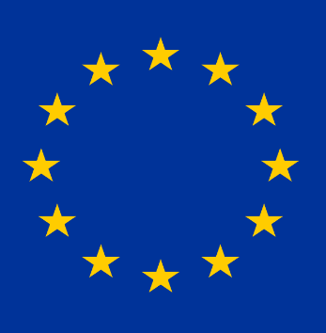
New organisational setup (2/2)
The role of the CNPD
Compliance
Administration
Guidance
CNPD
Sanctions
On-site inspection
Audit
Certification
Data breach
Subject matter experts
Stakeholders
GDPR
European cooperation
Commissioners
Head of investigation
Investigator
Expert
General Data Protection Regulation
Notes:
-procedure to open an investigation: Commissioners: take the decision to open an investigation
Head of investigation: member of the commission which oversees the investigation
Investigator is part of Staff specifically trained by the head of investigation, has a legitimation card to identify himself
Expert: internal (one of the subject matter experts mentioned before) or possibly external in case of very specific subjects
Commission (without the head of investigation) + staff member responible for sanctions = decision on the outcome of the investigation

Slide 70
Evolution of the CNPD
Staff
2014
15
2017
25
2018
35
Notes:
-budget of 2018 almost doubled in comparison to 2017
-staff including the Commissioner

Slide 71
Territorial jurisdiction of the CNPD
The role of the CNPD
Jurisdiction on the territory of Luxembourg
Introduction of the “one stop shop”
  One single point of contact for companies established in several Member States
  “lead authority” will be:
    authority of the main establishment of the controller
    place of the sole establishment of the controller
Reinforced EU cooperation between the « lead authority » and « concerned » authorities
  Aim is to adopt a single decision
  In case of disagreement → binding decision by the "European Data Protection Board"
Notes:
The main establishment will be either the place of the central administration in the EU, or the place where decisions on the purposes and means of the data processing are made.
→This authority shall be solely competent to supervise the processing of that controller in the Union and shall be the sole contact with that controller (or processor).
-but local competence remains possible, which means that even in the case of "cross-border" data processing, each national supervisory authority may remain competent to deal with a complaint or a violation of the GDPR if the object concerns only the establishment in that Member State or only affects data subjects in that state. The "lead" authority will then decide (within three weeks) whether it will process the case itself or whether the local authority will handle the case at local level.
The "lead" authority has therefore an obligation to cooperate with the other “concerned" supervisory authorities with a view to reach a consensus in the event of a potential debate.
A supervisory authority may be "concerned" if:
A company or its processor is also established in the territory of the state of that authority,
the persons residing in that state are significantly affected,
the complaint was lodged with that authority
If the "lead" authority prepares a draft decision, the supervisory authorities "concerned" may then approve or object to this project. In case of disagreement, the matter will be referred to the "European Data Protection Board" who will make a binding decision (which is called the “consistency mechanism“). The "lead" authority then adopts its final decision in accordance with the Board’s binding decision.

Slide 72
A paradigm shift
Removal of prior formalities (notifications / authorisations)
prior monitoring
Principle of Accountability
subsequent control
  less bureaucracy, yet more demanding for controllers and processors
Notes:
-before mentionning the different tasks of the CNPD, important to talk about the paradigm shift introduced by the CNPD

Slide 73
Tasks (1)
The role of the CNPD
Monitor and enforce the application of the data protection framework
Advise the national parliament and government
Provide guidance and inform the general public
Handle complaints and conduct investigations
Accredit the certification bodies
Cooperate with other supervisory authorities
Publish an annual activity report including:
  A list of types of infringement notified
  A list of types of imposed sanctions
Initiation to data protection – 04/09/2018
Notes:
-advises to the legislator concerning all draft bills foreseeing the creation of a data processing
-Raise public awareness + inform the general public (like these sessions here) + p.ex: brochure on data subject’s rights
-Provide guidance to data controllers / processors (ex: guidance in 7 steps on how to prepare for the GDPR + brochure on the responsibilities of the controllers / processors)
-activity report may include a list of types of infringement notified and types of corrective measures taken by the CNPD

Slide 74
Tasks (2)
Présentation de la CNPD
Verify data breach notifications
DPIA: prior consultation of the CNPD in case of remaining high residual risks
Monitoring at the workplace (art. 261-1 CT):
  Possible request of a prior opinion by the CNPD :
    By the staff delegation or the concerned employees
    Deadline: within 15 days of the prior information
  CNPD has 1 month to answer
  Request has a suspensive effect
Notes:
obligation d’information collective préalable à l’égard de la représentation du personnel, en plus de l’information individuelle des salariés
La nouvelle version de l’article L. 261-1 du Code de travail prévoit que, sauf lorsque la surveillance répond à une obligation légale ou règlementaire, la vidéosurveillance doit faire l’objet d’une codécision entre l’employeur et la délégation du personnel (ou comité mixte) et ce, conformément aux articles L. 211-8, L.414-9 et L. 423-1 du Code de travail, lorsqu’elle est mise en œuvre pour les finalités suivantes :
1.pour les besoins de sécurité et de santé des salariés, ou
2.pour le contrôle de production ou des prestations du salarié, lorsqu’une telle mesure est le seul moyen pour déterminer le salaire exact, ou
3.dans le cadre d’une organisation de travail selon l’horaire mobile conformément au Code du travail.
Collective prior information + individual information
Co-decision employer + staff delegation in certain cases

Slide 75
Tasks (3)
The role of the CNPD
Widening of competence to include processing activities in criminal / national security matters:
  Old system: « Article 17 » Supervisory Authority (State Public Prosecutor + 2 members of the CNPD)
  Law of 1 August 2018 implementing Directive 2016/680:
    Processing operations by competent authorities for criminal purposes : competence of the CNPD
    Exception for processing operations by courts + public prosecutor when acting in their judicial capacity : competence of a judicial control authority (≠ CNPD)
Initiation to data protection – 04/09/2018
Notes:
-Directive 2016/680: needs to be transposed for 6 May 2018, waiting for the opinion of the Conseil d’Etat
-competent authorities : jurisdictions (judicial and administrative), Police, customs, prisons, secret service, army

Slide 76
Investigative powers
Art. 58 of the GDPR: Each supervisory authority shall have all of the following investigative powers:
  to carry out investigations in the form of data protection audits;
  to obtain, from the controller and the processor, access to all personal data […];
  to obtain access to any premises of the controller and the processor […];

Slide 77
The right balance
Intervention in the legislative procedure
Raise public awareness to potential risks
Raise the awareness of controllers
Investigations following a complaint or on own initiative
Intervention following a data breach
Corrective measures
Adm.
fines

Slide 78



The role of the CNPD
Different types of investigations
On-site inspection
Inspection at the premises of the controller / processor
Specific/limited scope
One-off visit – where applicable triggers a file inspection
File inspection
Questionnaire including a document request
Review of answers and other relevant documents
Switch to on-site inspection or data protection audit according to preliminary results
Data protection audit
In depth review – broader in scope
Multiple exchanges in form of meetings
Risk based approach – refinement of scope during audit execution
communication to exchange information and documents
Initiation to data protection – 04/09/2018
Notes:
On site inspection– exemples:
Check the installation of a videosurveillance system
Check the data retention period of data included in a human ressources system
File inspection:
Analyse the different DPIA concerning their relevance, content and the conclusions
Analyse the information notices given to the data subjects
Or analyse the contracts concluded with data processors to check whether the obligatory mentions have been included
Data protection audit:
More general and complete review of the documentation necessary based on the accountability principle
-possible to switch from one type of investigation to another depending on the needs of each case (1. ex: following the analysis of the answers in the context of a file inspection it appears that the file needs a more global review → data protection audit

Slide 79
Corrective powers
The role of the CNPD
Issue warnings and reprimands
Order the controller/processor to bring processing operations into compliance with the GDPR
Impose a temporary or definitive limitation, including a ban on processing
Power to impose administrative fines:
  Major innovation for the Grand Duchy
  Imposed in addition, or instead of, other corrective measures
Infringements can be subject to a max. administrative fine of up to 20 million EUR, or in the case of an undertaking, up to 4 % of the total worldwide annual turnover of the preceding financial year.
Initiation to data protection – 04/09/2018
Notes:
Administrative fines shall be effective, proportionate and dissuasive + shall depend on the circumstances of each individual case

Slide 80
Legal remedies
Right for every data subject to lodge a complaint
  with a supervisory authority of the MS of the data subject’s habitual residence, place of work or place of the alleged infringement
Right to an effective judicial remedy against a supervisory authority
  against a legally binding decision concerning a data subject
  against a failure to reply within 3 months
  competence of the courts of the MS where the supervisory authority is established:
    Competence of the Luxembourgish Administrative Tribunal “Tribunal administratif” deciding on the merits of the case

Slide 81
Increase of complaints (2017)
Notes:
2017_: 200 complaints, majority concern lawfulness of certain adm / commercial practises

Slide 82
Increase of written information requests (2017)
The role of the CNPD
Initiation to data protection – 04/09/2018
Notes:
2017: 520 information requests, half of them came from companies, but also a lot from citizens, as well as from public institutions and also from different laywers
-most questions concerning logically the GDPR, but a lot of different topics (monitoring at the workplace, keep a recourd of processing activities, nomination of a DPO, prior formalities vs reinforced investigations by the CNPD, a lot of questions concerning the financial sector as well as the medical data)

Slide 83
Legal opinions (2017)
The role of the CNPD
Notes:
-slight decrease (22) in comparison with 2017, but that was really an exceptional high amount of opinions (30), ex: bill n° 7128: fight against money laundering and financinf of terrorism, bill n°7168 concerning the protection of your data in criminal / national security matters, n°7136 implementing the package travel directive or n°7151 transposing the passenger name record directive

Slide 84
Statistics for 2018
Notes:
Réclamations: 2017: 200, 2018: 240
DI: 520 et 818
Avis: de 22 à 27

Slide 85

Commission nationale pour la protection des données
Thank you for your attention!

